Slide 1




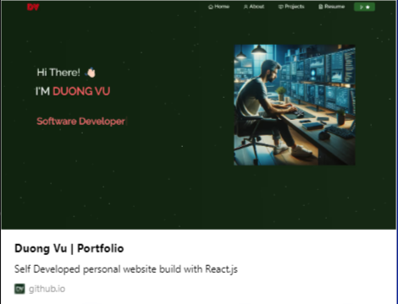

CPSC-362
PERSONAL PORTFOLIO
WEBSITE
By Duong Vu
https://amao4t.github.io/myportfolio/

Slide 2
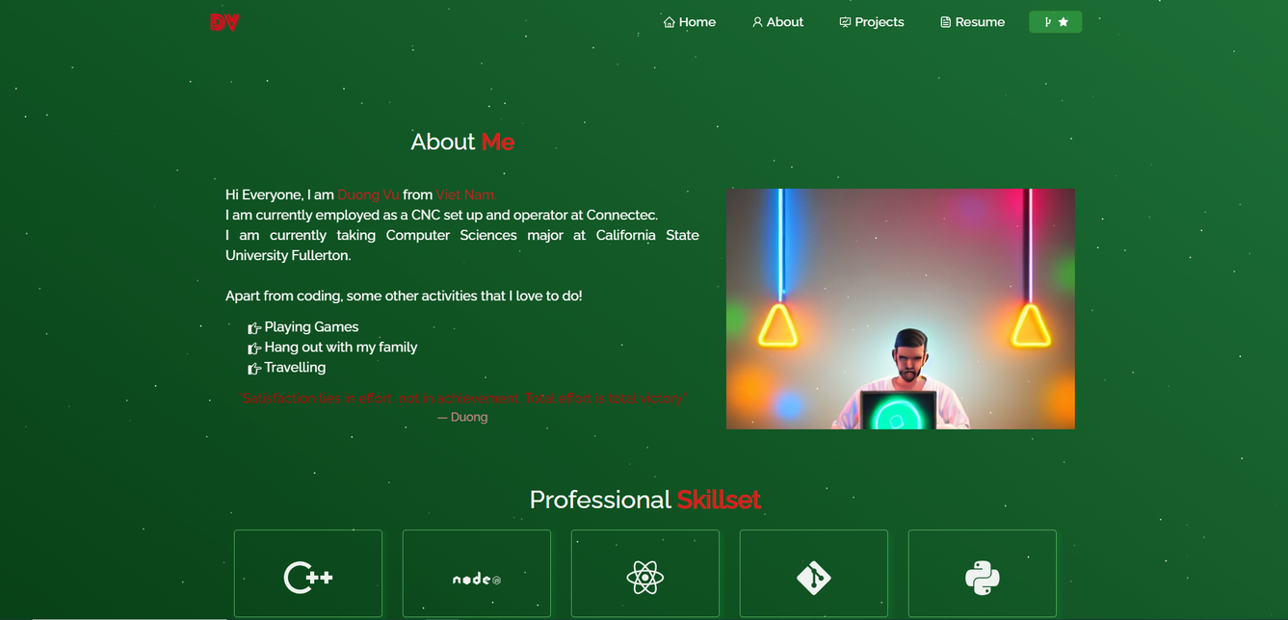
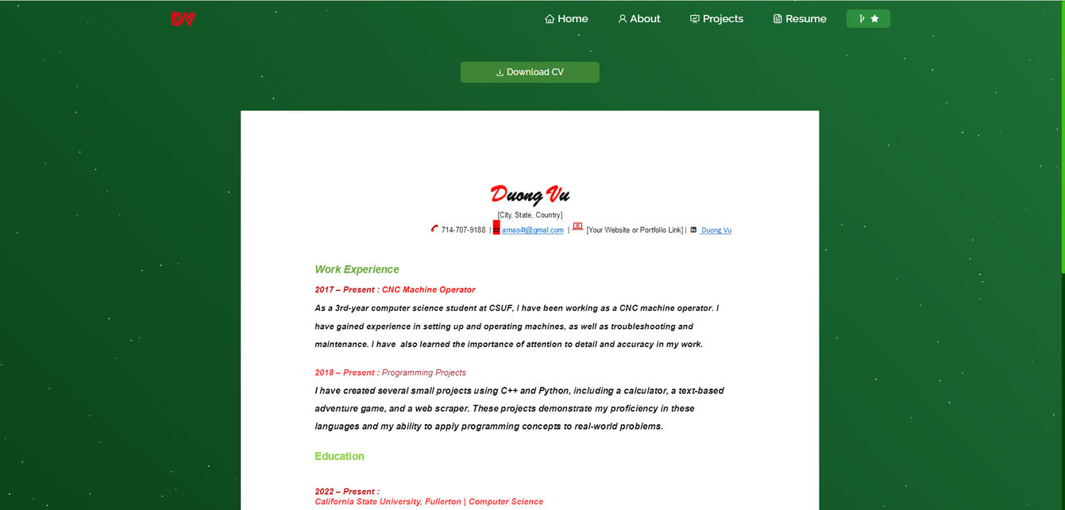
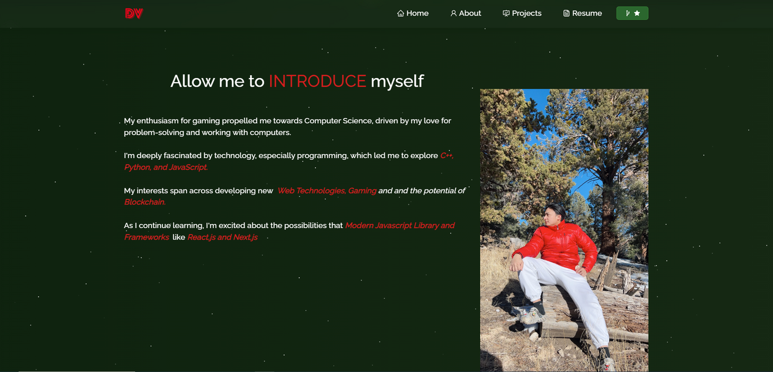
INTRODUCTION
Personal Portfolio Website
+ Comprehensive display of my work, skills, and experiences
+ This portfolio is built using modern web technologies like React.js and Node.js, and it's designed to serve as a digital representation of my professional journey.

Slide 3


PORTFOLIO GOALS & PORTFOLIO SECTIONS
Portfolio Goals
Showcase my professional skills and projects.
Serve as a digital CV for potential employers or collaborators.
Establish my personal brand and online presence
Portfolio Sections
Home: A welcoming introduction.
About: Outlines my professional background, skills, and interests.
Projects: Showcases selected works with descriptions and links.
Resume: Summarizes my education, experience, and achievements.
Contact: Provides a way for potential employers or collaborators to reach out."

Slide 4

TECHNOLOGY STACK
NODE.JS
CSS3
&
BOOTSTRAP
REACT.JS
GITHUB PAGES
for dynamic user interfaces
for backend support.
for responsive and aesthetic design.
for easy deployment and maintenance.

Slide 5

LEARNING
React Application Development: I gained hands-on experience in developing a React application, understanding its structure, and working with components to create a dynamic and responsive user interface.
Deployment to GitHub Pages: I learned how to deploy a React application to GitHub Pages, including configuring my project's package.json file, using the gh-pages package, and troubleshooting deployment issues.
Working with npm and Dependency Management: Encountering and resolving npm errors provided insight into dependency management, version conflicts, and the importance of compatible library versions within my React project.
Understanding Peer Dependencies: The npm error related to peer dependencies highlighted the complexities of managing dependencies in modern web development, specifically how certain libraries rely on specific versions of other libraries (e.g., React).
Command Line Proficiency: Throughout the process, I enhanced my command-line skills, executing commands for installing packages, starting the development server, and deploying my application.
Version Control with Git: This project likely reinforced my understanding of version control using Git, emphasizing the importance of committing changes, branching, and pushing updates to GitHub.
Troubleshooting and Problem-Solving: I encountered various challenges, from deployment issues to configuration errors. Addressing these issues helped improve my troubleshooting and problem-solving skills, crucial for any software development project.
SEO and Web Presence: By customizing my project's metadata for GitHub Pages, I learned about the basics of SEO (Search Engine Optimization) and the importance of metadata in improving the visibility of my web projects.
Markdown and Documentation: Writing a README and preparing for a presentation underscored the importance of documentation, both for users who might visit my portfolio and as a personal reference.
Presentation Skills: Preparing to present my project, even in a written format, helped in organize my thoughts, structure my presentation content, and communicate my achievements effectively.

Slide 6
SPECIFIC ERRORS
npm Peer Dependency Errors: Another significant hurdle was resolving npm errors related to peer dependencies. This situation occurred when attempting to install a package that required a different version of React than what was installed in my project. It underscored the complexity of dependency management in JavaScript projects, teaching me to pay close attention to version compatibility and the interconnectedness of various libraries. This experience improved my ability to diagnose and fix compatibility issues, making me more adept at managing project dependencies.
Cache Issues Affecting Project Visibility: I encountered a scenario where my project updates were not visible immediately due to browser caching. This issue was enlightening because it introduced me to the concept of cache control and the strategies to ensure that the latest version of a site is always served. Learning to clear the cache and implement cache control headers has been invaluable for web development, ensuring users always see the most current content.
Responsive Design Challenges: Making my project fully responsive on mobile devices was another area where errors provided significant learning opportunities. It highlighted the importance of responsive design principles, CSS media queries, and testing on various devices to ensure a seamless user experience across all platforms.

Slide 7
CPSC-362
Thank You For
Listening!!!
By Duong Vu
https://amao4t.github.io/myportfolio/

